Slide 1
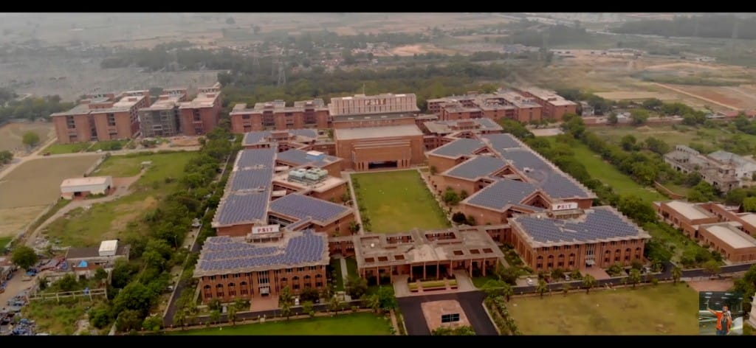
MY COLLEGE MAP
Project By -
Yash Srivasatava
Yash Shukla
Parth Gupta
Priyansh Srivasatava

Slide 2
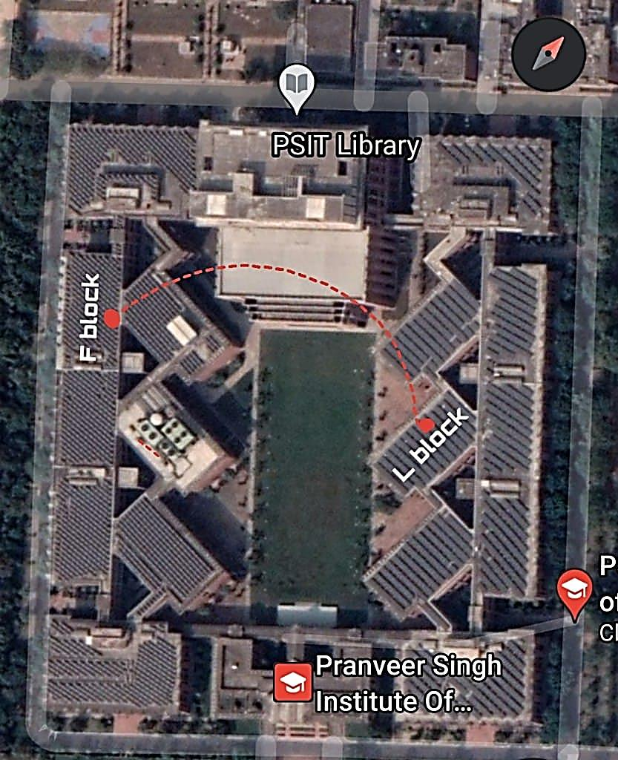

Need Of An Online Map Software
We have to travel a lot as we can’t find the shortest path to reach our destination.
This can be solved by this software.

Slide 3
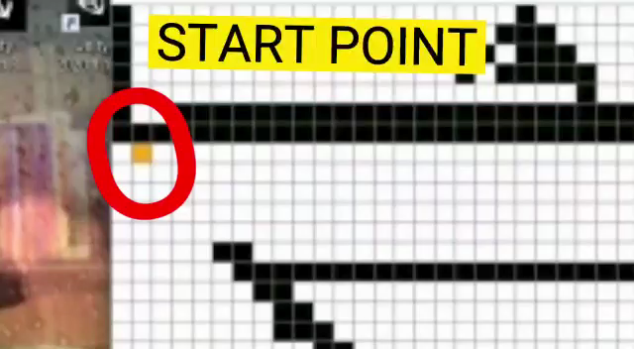
The Idea Behind The Project
We came up with idea of making a
2D model of college and perform the
algorirtm layer by layer
To get the location by shortest path

Slide 4
Some More Features Of Our Software
It have all the important buildings like admin,library,classes.
It will detect the shortest path to reach any location.
It has the location of all near by water dispensers.
It has feature to locate your friends .

Slide 5
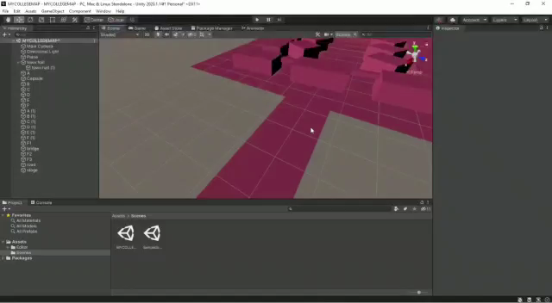
A 3D representation of our college

Slide 6
The Algorithm and software used in this Project
We have used the back track algorithm to find the shortest distance between two locations.
We used Python for back tracking in 2D coordinates .
We used standalone-unity 2020 for graphics to make 3D model.

Slide 7
THANK YOU

